Slide 1

Machine Breakdown and Maintenance Analysis
Conducted By
Tanvi Kulkarni

Slide 2
TABLE OF CONTENT
Project Overview
Objectives
Data Set
Recommended SQL Analysis
Data Manipulation Process
Key Metrics
Report
Insights & Recommendations
Recommended Power BI Analysis

Slide 3
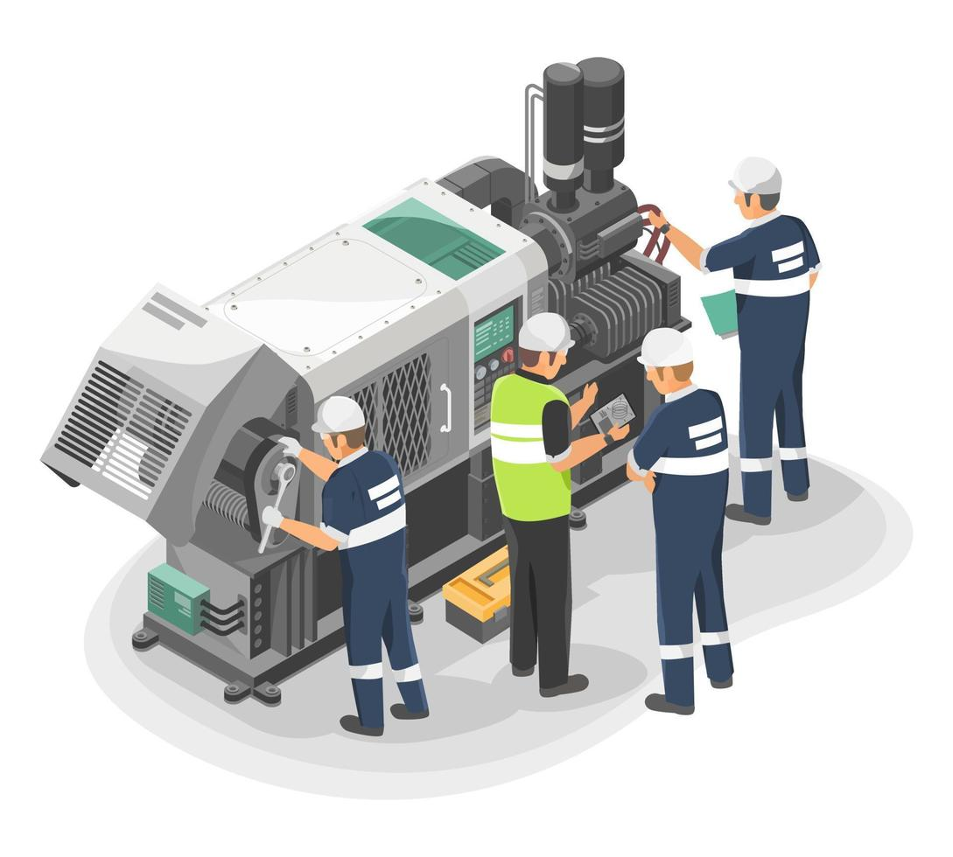
Project Overview
This project involves analyzing machine data related to breakdowns and maintenance. It focuses on understanding patterns and factors affecting machine performance.

Slide 4

Objective The objective of this project is to conduct an analysis to identify the factors that impact machine downtime, repair costs, and productivity.
Tools Used :
SQL & Power BI

Slide 5
Data Set
No. of Rows-178464 No. of Columns-45
Dataset Name : Machine Data
Type of Data : CSV

Slide 6
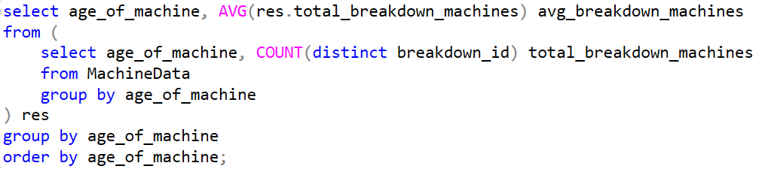
Recommended SQL Analysis
1. Analyze the machines by their age and calculates the average number of breakdowns for each age group to see if older machines tend to break down more often.

Slide 7
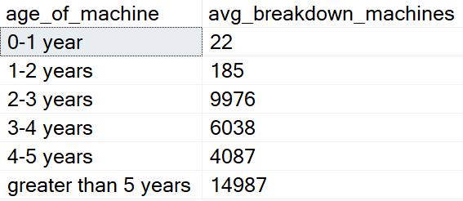
Analysis
The machines those are over 2 years of age lead to have more breakdowns

Slide 8
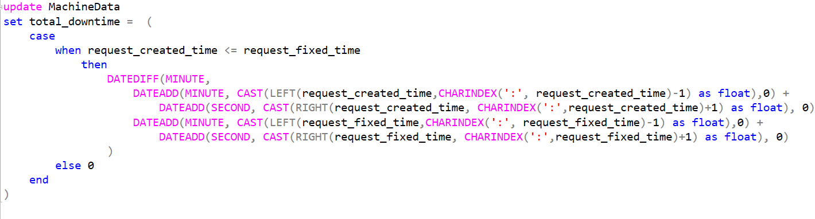
Recommended SQL Analysis
2. Identify the top 5 breakdown-prone machines and their associated downtime.
Step 1 : To calculate total_downtime I have created new column in MachineData table and replace the values using below logic.

Slide 9
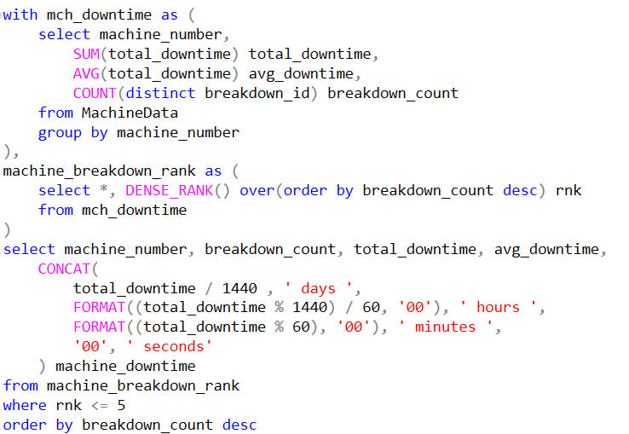
Step 2 : Display top 5 breakdown prone machines with their downtime

Slide 10
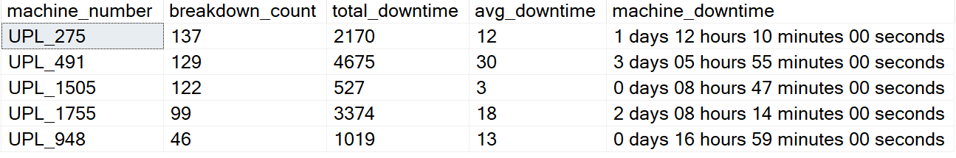
Analysis
The machine UPL_275 has the highest breakdown_count 137 but it has a lower downtime as compared to machine UPL_491 and UPL_1755.

Slide 11
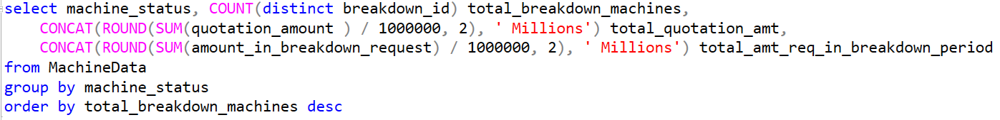
Recommended SQL Analysis
3. find the pattern of the cost impact of breakdowns by machine state.

Slide 12
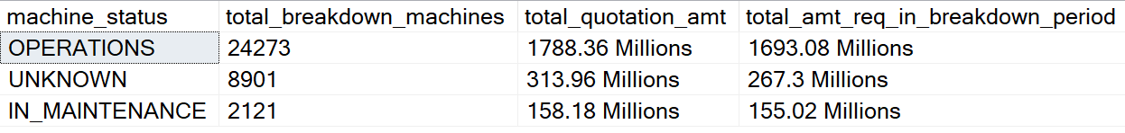
Analysis
The machines those status is operations have highest breakdown count and the total cost required is also highest.

Slide 13
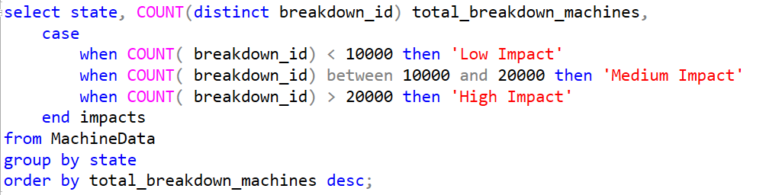
Recommended SQL Analysis
4. Identify the impact of machine location on breakdown frequency.

Slide 14
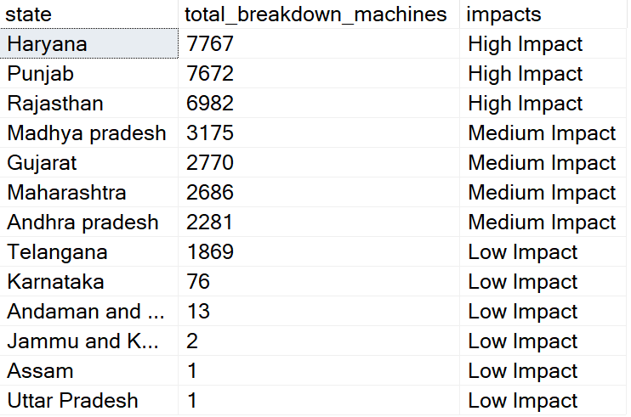
Analysis
Haryana, Punjab, Rajasthan have the highest number of breakdowns
Gujarat, Madhya Pradesh, Maharashtra, Andhra Pradesh have the medium number of breakdowns
Telangana, Karnataka, Andaman and Nicobar Islands, Jammu and Kashmir, Assam, Uttar Pradesh have the lowest number of breakdowns

Slide 15
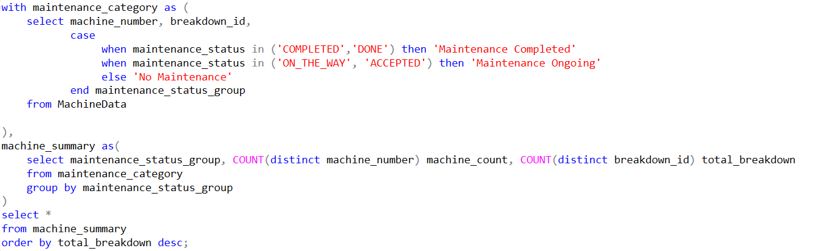
Recommended SQL Analysis
5. compares the breakdown frequency of machines that underwent preventive maintenance against those that didn't, to assess the impact of maintenance on machine reliability.

Slide 16
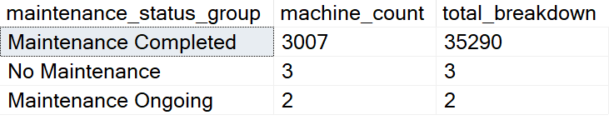
Analysis
Total breakdown count is more for the machines whose maintenance status is completed.
For Maintenance ongoing and No Maintenance status both has a smaller number of breakdowns as compared to Maintenance Completed.

Slide 17

Data Manipulation Process
Power BI Analysis
Measures
Total Machines
Total Breakdowns
Average Quotation Cost
Average Breakdown Cost
Average Downtime
Filters & Slicers
Filter breakdown-prone machines by breakdown count
Filter nulls from columns
State Slicer
Machine Status Slicer
Breakdown Category Slicer
Maintenance Status Slicer
Calculated Columns
Downtime in Minutes
Maintenance Status Category

Slide 18

Key Metrics
The key matrices for this project include:
Machine Summary: Total Machines, Machines by Active Status, State-wise Machine Count
Machine Breakdowns: Total Breakdowns, Breakdowns by Category, Breakdown by Age of Machine, Breakdown by Maintenance Status, Breakdown by State
Downtime Analysis: Total Downtime, Breakdown-prone machines and their average downtime.
Cost Analysis: Average breakdown cost, Breakdown cost by machine_status, Average quotation amount assigned to breakdown machines

Slide 19
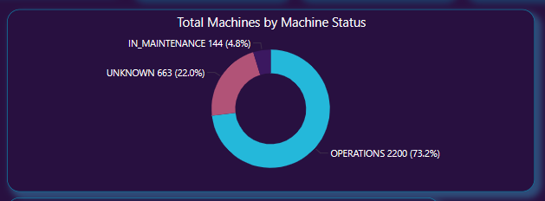

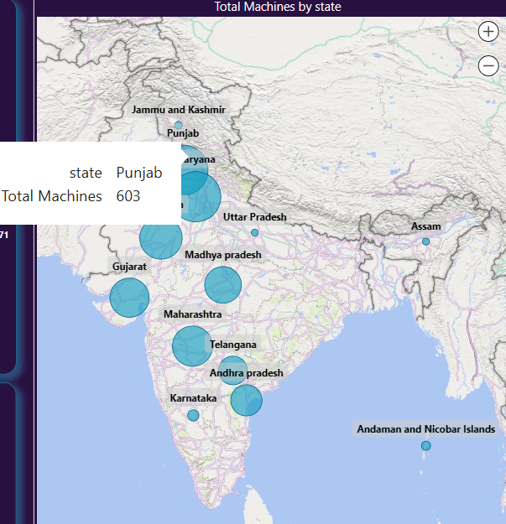
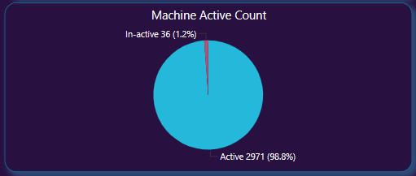
Recommended Power BI Analysis
Machine Summary
Breakdown Summary
Cost Analysis
There are a total of 3007 machines, with 2971 currently active. Most of these machines are in the operational state, and Punjab has the highest number of machines listed.
Downtime Analysis

Slide 20
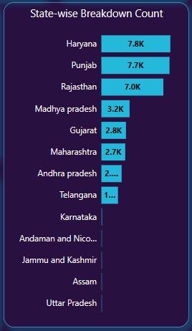

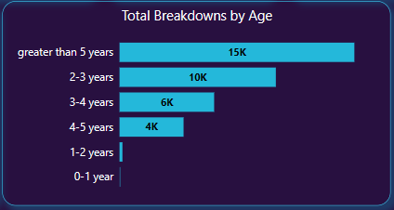
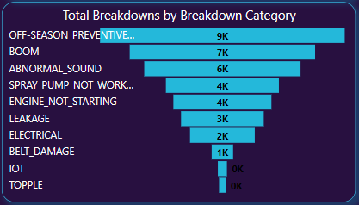
Recommended Power BI Analysis
Machine Summary
Breakdown Summary
Cost Analysis
There are a total of 3007 machines, with 2971 currently active. Most of these machines are in the operational state, and Punjab has the highest number of machines listed.
There are around 35,000 breakdowns. Machines over 5 years old and those in the off-season preventive service category have the most breakdowns, with Haryana leading in breakdown counts.
Downtime Analysis

Slide 21

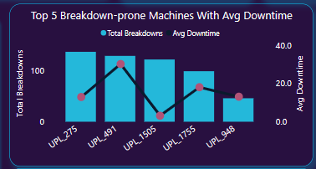
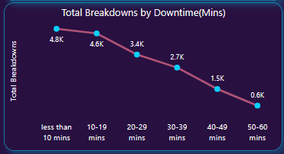
Recommended Power BI Analysis
Machine Summary
Breakdown Summary
Cost Analysis
There are a total of 3007 machines, with 2971 currently active. Most of these machines are in the operational state, and Punjab has the highest number of machines listed.
There are around 35,000 breakdowns. Machines over 5 years old and those in the off-season preventive service category have the most breakdowns, with Haryana leading in breakdown counts.
Downtime Analysis
The average downtime is 10 minutes. Machine UPL_491 has the maximum downtime of 30 minutes. Most machines have a recorded downtime of less than 10 minutes.

Slide 22


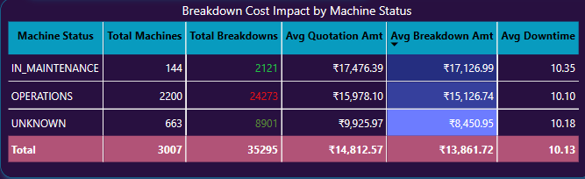
Recommended Power BI Analysis
Machine Summary
Breakdown Summary
Cost Analysis
There are a total of 3007 machines, with 2971 currently active. Most of these machines are in the operational state, and Punjab has the highest number of machines listed.
There are around 35,000 breakdowns. Machines over 5 years old and those in the off-season preventive service category have the most breakdowns, with Haryana leading in breakdown counts.
Downtime Analysis
The average downtime is 10 minutes. Machine UPL_491 has the maximum downtime of 30 minutes. Most machines have a recorded downtime of less than 10 minutes.
The average quotation is ₹14.81k, and the average breakdown cost is ₹13.86k. In Maintenance machines have the highest breakdown cost of ₹17k and the most downtime, despite fewer breakdowns. Machines in Operation status have more breakdowns but lower costs and downtime.

Slide 23

Power BI Report

Slide 24
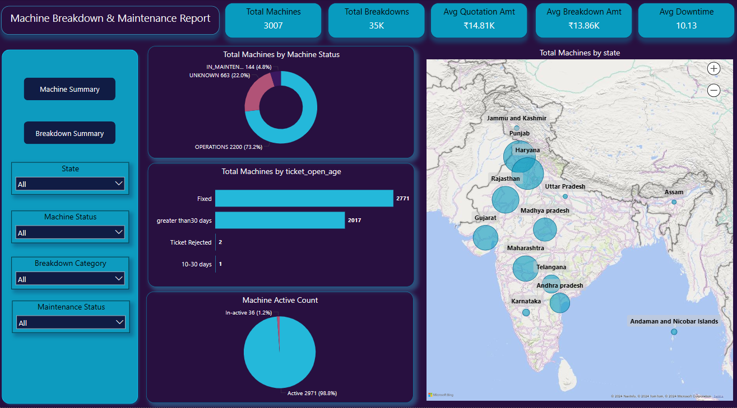
Machine Summary Report

Slide 25
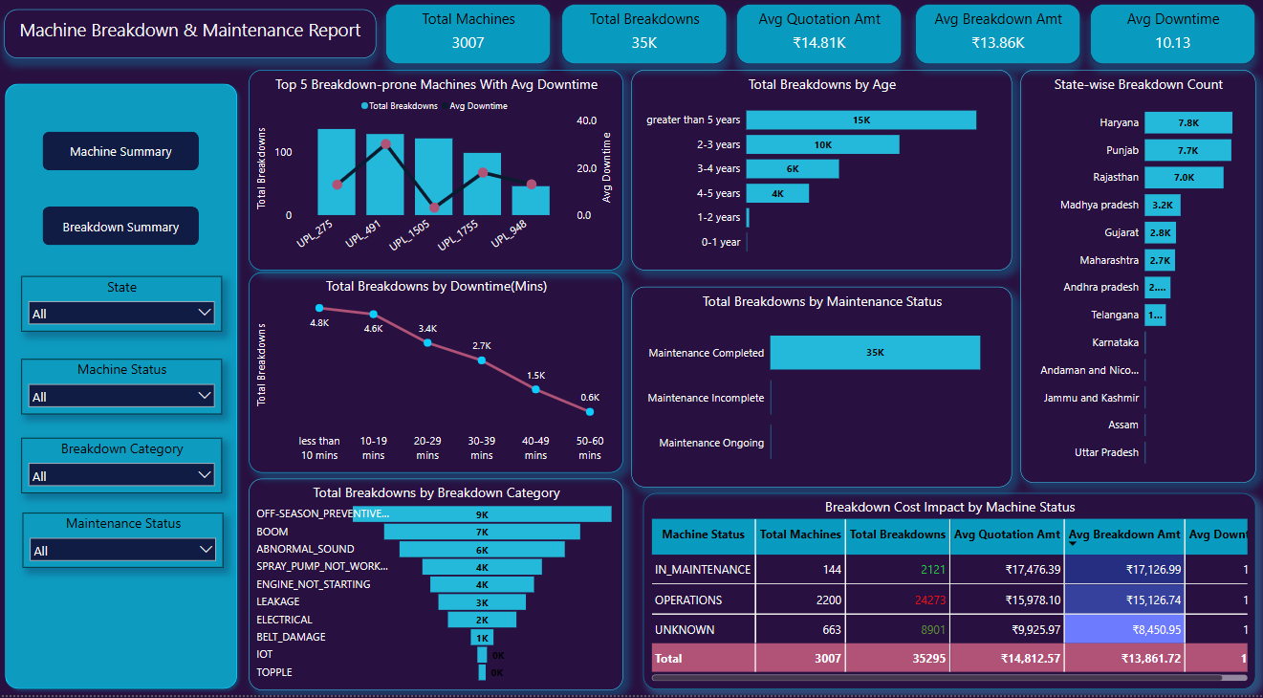
Machine Breakdown Summary Report

Slide 26
Insights & Recommendations
Age of Machine
Insight: Older machines have higher breakdowns, while newer ones have fewer.
Suggestion: Prioritize frequent preventive maintenance for older machines and continuously monitor them to catch issues early and prevent breakdowns. If a machine frequently requires maintenance and drives up costs, consider replacing it.
Downtime of Machine
Insight: Machines with the highest breakdown counts have lower downtime.
Suggestion: For machines with maximum downtime despite fewer breakdowns, identify factors contributing to high downtime, such as machine age or maintenance cycle, to address the specific issues effectively.
Impact of Location on Breakdowns by Machine State & Maintenance Status
Insight: Machines in Operation state with Completed maintenance have the highest breakdowns & costs, with Haryana, Punjab, and Rajasthan leading in counts.
Suggestion: We need to analyze factors such as machine usage, maintenance quality, and environmental conditions. Understanding these aspects will help identify underlying issues and improve overall performance.

Slide 27
Thank you

